Slide 1
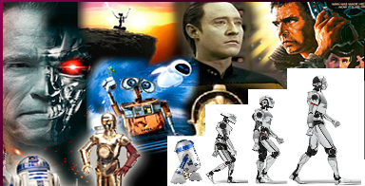
371323864
372427616
377845128
Final AIDA Project
Image Captioning
April 26 to 30, 2021 Andras Baligacs, Rainer-Anton Englisch, Thomas Schremser
Functional Colors
Red (Functional)
Yellow (Functional)
Green (Functional)

Slide 2
Agenda
Mission, Approach and Results
Technical Details

Slide 3
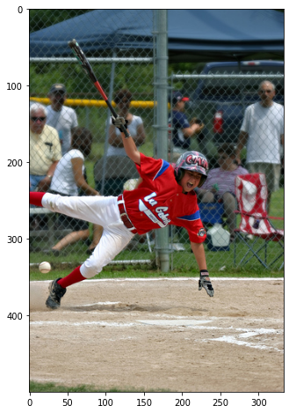
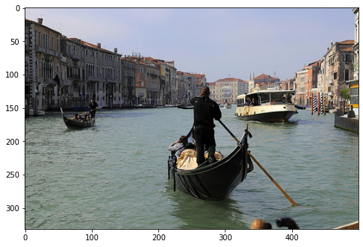
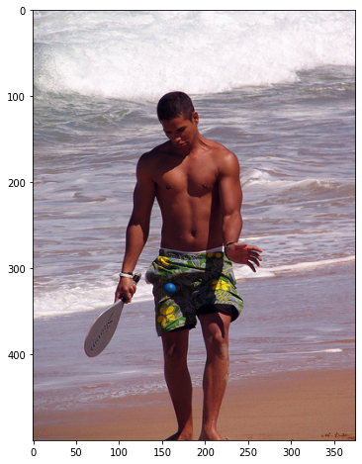
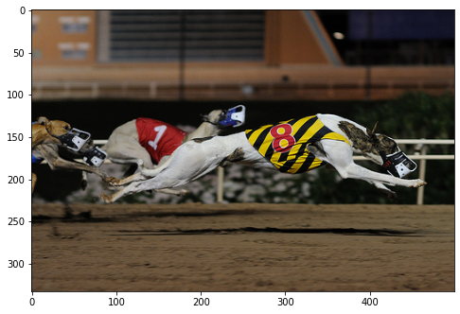
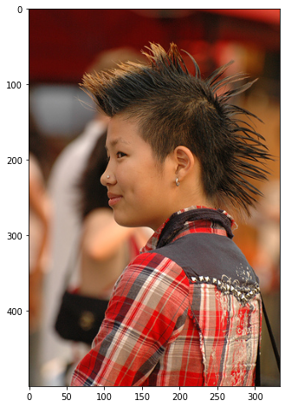
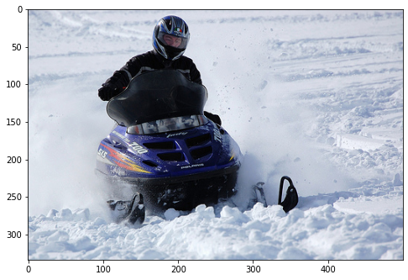
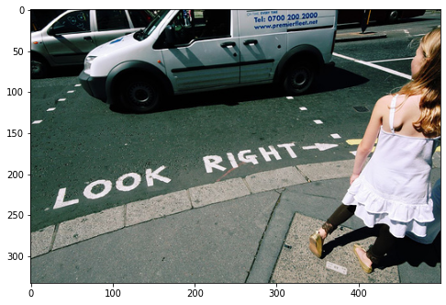
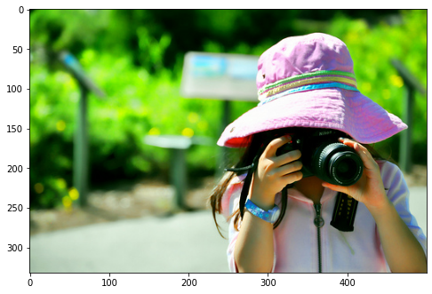
Mission
A man in swim trunks hits a ball with a paddle , while on the beach
A baseball player runs on the field
A gondola is steered through the canals with other boats around
A dog wearing the number 8 leads in a dog race
Build up a Model for captioning pictures!
A girl with a nose ring , earring and Mohawk
A man riding a purple snowmobile
A little girl in a pink hat holds a camera to her face
A girl is on the sidewalk looking at a white van in the street

Slide 4
Solution Context
Encoder-Decoder Architecture
flickr 8k data collection
ROUGE-L Recall and BLEU-1 Precision metrics
https://kobiso.github.io/Computer-Vision-Leaderboard/imagenet.html
Notes:
Convolutional neural network which

Slide 5
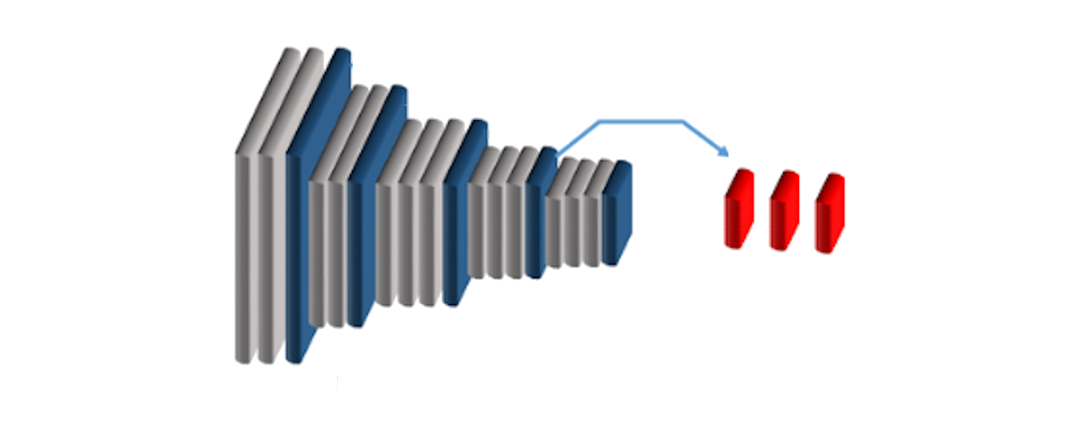
Encoder-Decoder Architecture
A baseball player runs on the field
Encoder - Part (CNN) Decoder - Part (RNN)
Notes:
GRU: Gated Recurrent Unit
LSTM: Long Short-Term Memory layer
Inception v3:
Inception V3 by Google is the 3rd version in a series of Deep Learning Convolutional Architectures. Inception V3 was trained using a dataset of 1,000 classes (See the list of classes here) from the original ImageNet dataset which was trained with over 1 million training images, the Tensorflow version has 1,001 classes which is due to an additional "background' class not used in the original ImageNet. Inception V3 was trained for the ImageNet Large Visual Recognition Challenge where it was a first runner up.
Inception-Resnet-V2:
Convolutional neural network that is trained on more than a million images from the ImageNet database. The network is 164 layers deep and can classify images into 1000 object categories, such as the keyboard, mouse, pencil, and many animals. As a result, the network has learned rich feature representations for a wide range of images. The network has an image input size of 299-by-299, and the output is a list of estimated class probabilities.

Slide 6

flickr 8k data collection
8,091 JPG-ecoded color pictures
Each picture has labeled by five captions (sentences)

Slide 7
Example Picture
Reference captions:
A baseball hitter holding a bat falling down .
Baseball player runs on the field .
A boy at bat playing a baseball game falls to the ground while onlookers watch .
A child in a uniform is falling to the ground with a bat in his or her hand .
This baseball player, dressed in red and white uniform and holding a bat, is falling after being hit by a pitch .

Slide 8

Metrics
ROUGE-L Recall*
Measures the longest matching sequence of words between reference and candidate sentence
perfect match = 1 | 0 = no match
------------------------------------------------------------------------------------------------------------------------------------------------------------------------------------------------------------------------------------------------------------------------------------------------------------------------------------------------------------------------------------------------------------------------------------------------------------------------------------------------------------------------
BLEU-1 Precision**
Measures the matching of words (unigrams, 1-grams) between reference and candidate sentence
perfect match = 1 | 0 = no match
* Recall: related to the number of words in reference sentence ** Precision: related to the number words in of candidate sentence
Notes:
ROUGE-L: Recall-Oriented Understudy for Gisting Evaluation - Longest common subsequence
BLEU-1 : Bilingual Evaluation Understudy

Slide 9
Our Approach
Planning architecture high level and do researches
Build up Baseline model
Create custom function for ROUGE-L and BLEU-1 calculation
Preprocessing text sentences (lower case, special characters)
Model generation iterations:
Preprocessing Pictures and CNN features for RNN input (resizing)
Running trainings and predictions
Build up further models or change hyper-parameters of existing models
https://kobiso.github.io/Computer-Vision-Leaderboard/imagenet.html
Notes:
Convolutional neural network which

Slide 10
Results
Model | Train |  | Test
 | BLEU-1 | ROUGE-L | BLEU-1 | ROUGE-L
Baseline | 0.5901 | 0.5149 | 0.4008 | 0.3579
InceptV3 GRU NoAttention CustEmbedding | 0.5794 | 0.5093 | 0.4036 | 0.3646
InceptV3 LSTM Attention CustEmbedding | 0.4401 | 0.4520 | 0.4464 | 0.4537
InceptV3 GRU NoAttention CustEmbedding 768-units-all | 0.6102 | 0.5415 | 0.4028 | 0.3639
Baseline Glove Word vectors | 0.6715 | 0.5893 | 0.3968 | 0,3592
Baseline Glove Word vectors 2x LSTM | 0.2631 | 0.4028 | 0.2503 | 0.3515
Inception-ResNet-V2 GRU NoAttention CustEmbedding | 0.4934 | 0.4023 | 0.4401 | 0.3624
Notes:
Aussage zu Balancierung des Data Sets
ohne threshold *

Slide 11
Results
Model | Train |  | Test
 | BLEU-1 | ROUGE-L | BLEU-1 | ROUGE-L
Baseline | 0.5901 | 0.5149 | 0.4008 | 0.3579
InceptV3 GRU NoAttention CustEmbedding | 0.5794 | 0.5093 | 0.4036 | 0.3646
InceptV3 LSTM Attention CustEmbedding | 0.4401 | 0.4520 | 0.4464 | 0.4537
InceptV3 GRU NoAttention CustEmbedding 768-units-all | 0.6102 | 0.5415 | 0.4028 | 0.3639
Baseline Glove Word vectors | 0.6715 | 0.5893 | 0.3968 | 0,3592
Baseline Glove Word vectors 2x LSTM | 0.2631 | 0.4028 | 0.2503 | 0.3515
Inception-ResNet-V2 GRU NoAttention CustEmbedding | 0.4934 | 0.4023 | 0.4401 | 0.3624
Notes:
Aussage zu Balancierung des Data Sets
ohne threshold *

Slide 12
Winner Model
Model: InceptV3 LSTM Attention CustEmbedding
Encoder: InceptionV3 (256 units) Decoder: LSTM (512 units, 256 embedding size) ROUGE-L Recall (Test): 45.37 % BLEU-1 Precision (Test): 44.64 %
Loss (Test): 9.805 Loss (Train): 0.732
Training time: 30 minutes
Notes:
https://www.researchgate.net/figure/Schematic-diagram-of-a-basic-convolutional-neural-network-CNN-architecture-26_fig1_336805909

Slide 13
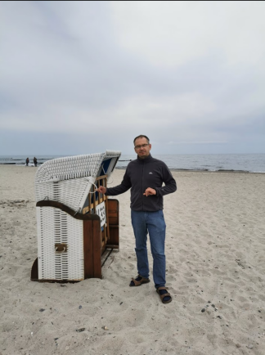
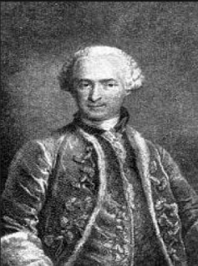
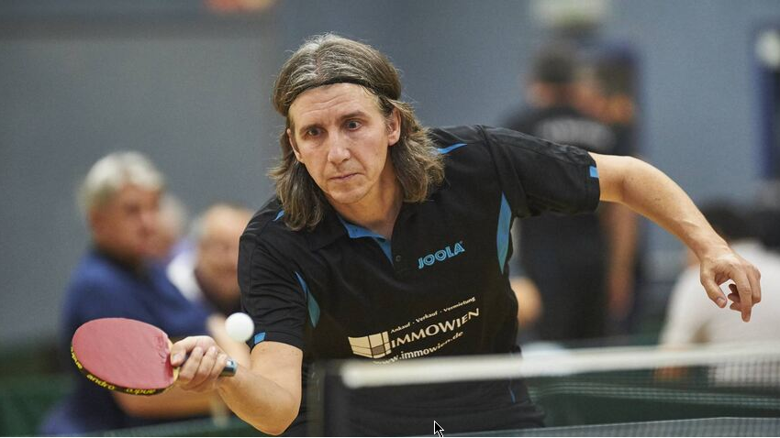
Reality Check
Predicted Caption
a man in a blue shirt is riding a bike down a dirt road
a boy in a red shirt is playing with a red toy
a man in a black jacket and a woman in a red shirt is looking at a man in a red shirt

Slide 14
Technical Details

Slide 15
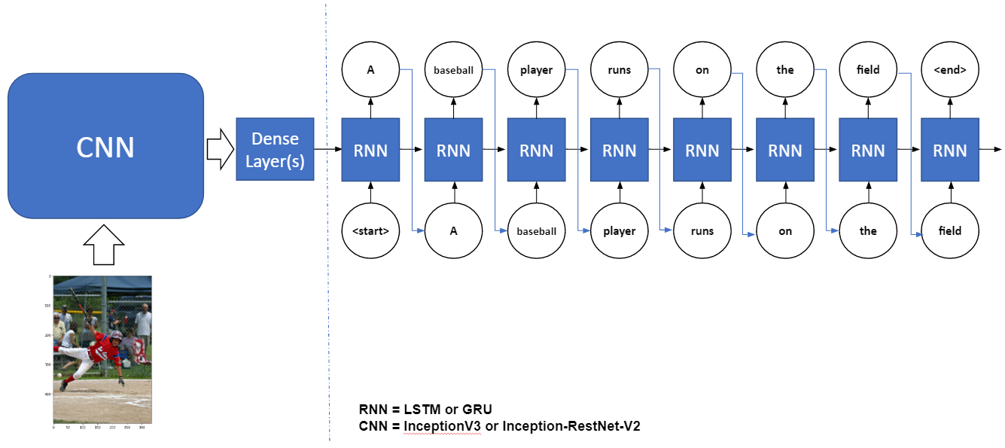
Encoder-Decoder Architecture
Decoder
Notes:
GRU: Gated Recurrent Unit
LSTM: Long Short-Term Memory layer
Inception v3:
Inception V3 by Google is the 3rd version in a series of Deep Learning Convolutional Architectures. Inception V3 was trained using a dataset of 1,000 classes (See the list of classes here) from the original ImageNet dataset which was trained with over 1 million training images, the Tensorflow version has 1,001 classes which is due to an additional "background' class not used in the original ImageNet. Inception V3 was trained for the ImageNet Large Visual Recognition Challenge where it was a first runner up.
Inception-Resnet-V2:
Convolutional neural network that is trained on more than a million images from the ImageNet database. The network is 164 layers deep and can classify images into 1000 object categories, such as the keyboard, mouse, pencil, and many animals. As a result, the network has learned rich feature representations for a wide range of images. The network has an image input size of 299-by-299, and the output is a list of estimated class probabilities.

Slide 16
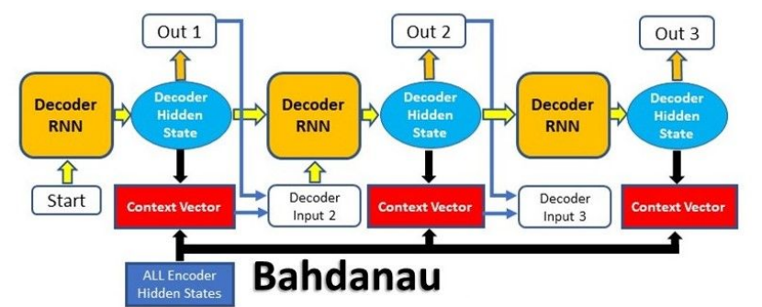
Attention Mechanism used
Decoder
Notes:
GRU: Gated Recurrent Unit
LSTM: Long Short-Term Memory layer
Inception v3:
Inception V3 by Google is the 3rd version in a series of Deep Learning Convolutional Architectures. Inception V3 was trained using a dataset of 1,000 classes (See the list of classes here) from the original ImageNet dataset which was trained with over 1 million training images, the Tensorflow version has 1,001 classes which is due to an additional "background' class not used in the original ImageNet. Inception V3 was trained for the ImageNet Large Visual Recognition Challenge where it was a first runner up.
Inception-Resnet-V2:
Convolutional neural network that is trained on more than a million images from the ImageNet database. The network is 164 layers deep and can classify images into 1000 object categories, such as the keyboard, mouse, pencil, and many animals. As a result, the network has learned rich feature representations for a wide range of images. The network has an image input size of 299-by-299, and the output is a list of estimated class probabilities.

Slide 17
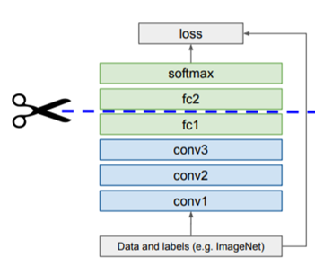
Preprocessing Pictures
Image Features
1007129816_e794419615.npy
Notes:
F1.- Result

Slide 18
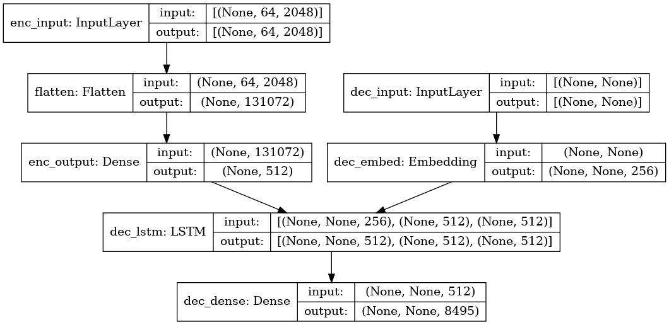
Preprocessing CNN features for RNN input
Image Features
1007129816_e794419615.npy
Notes:
F1.- Result

Slide 19
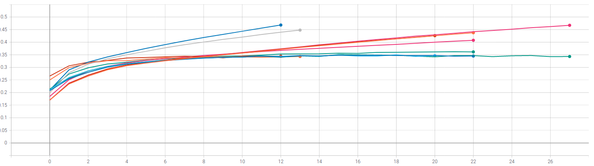
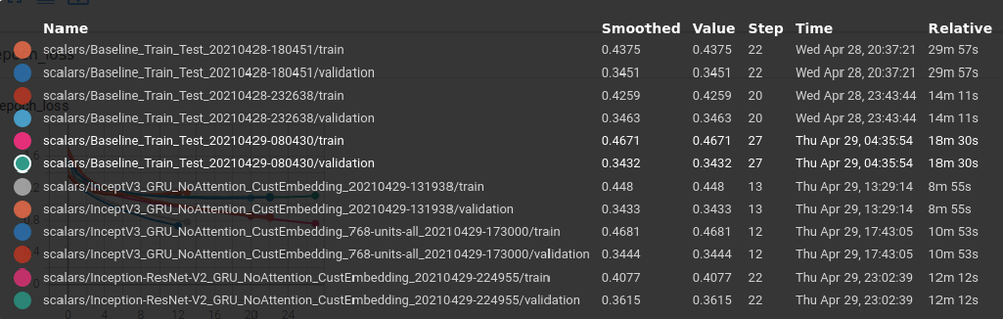
Accuracy per Epoch
Notes:
F1.- Result

Slide 20
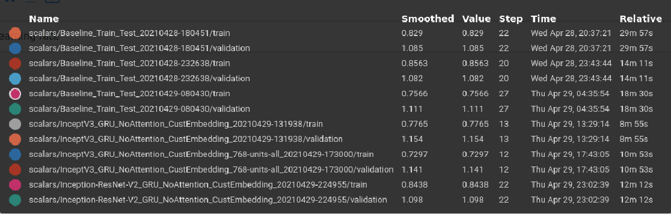
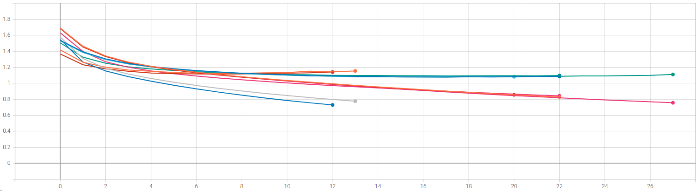
Loss per Epoch
Notes:
F1.- Result

Slide 21
Findings
Transformation of sentences to lower case and removement of special characters (comma, semicolon,…) improved performance
The implemented attention mechanism delivered a better performance
The models overfit We suspect that the reason is the relatively small size of the dataset A run with the flickr 30k dataset is recommended by the team
https://kobiso.github.io/Computer-Vision-Leaderboard/imagenet.html
Notes:
Convolutional neural network which

Slide 22
Beyond …

Slide 23
Results after project closing
Model | Train |  | Test
 | BLEU-1 | ROUGE-L | BLEU-1 | ROUGE-L
Baseline | 0.5901 | 0.5149 | 0.4008 | 0.3579
InceptV3 LSTM Attention CustEmbedding | 0.4401 | 0.4520 | 0.4464 | 0.4537
Transformer Attention (8 heads) | n.a. | n.a. | 0.5897 | 0.5481
InceptV3 GRU NoAttention CustEmbedding V2 | 0.8641 | 0.6710 | 0.5498 | 0.4287
InceptV3 LSTM NoAttention CustEmbedding V2 | 0.8200 | 0.6599 | 0.5544 | 0.4277
Inception-ResNet-V2 GRU NoAttention CustEmbedding V2 | 0.8576 | 0.6788 | 0.5352 | 0.4395
Notes:
Aussage zu Balancierung des Data Sets
ohne threshold *

Slide 24
Changes after project closing
Reducing vocabulary to 5,000 words
Reducing the picture preprocessing to already incorporated methods
Adding a transformer architecture
https://kobiso.github.io/Computer-Vision-Leaderboard/imagenet.html
Notes:
Convolutional neural network which

Slide 25
Reality Check after project closing
Predicted Caption
a man and a boy standing on a beach
a man in a black shirt is holding a ball with a crowd in the background
a dirty picture of a man wearing a red and gold coat

Slide 26
BACKUP

Slide 27
ROUGE-L Recall
Measures the longest matching sequence of words between reference and candidate sentence
(perfect match = 1, no match = 0)
Example: Reference sentence: police killed the gunman yesterday
Candidate sentences:
police kill the gunman -> ROUGE-L Recall = 3/5 = 0.6 -> longest sequence: police the gunman
the gunman kill police -> ROUGE-L Recall = 2/5 = 0.4 -> longest sequence: the gunman
Notes:
F1.- Result

Slide 28
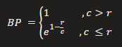
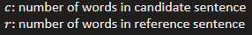
BLEU-1 Precision
Measures the matching of words (unigrams, 1-grams) between reference and candidate sentence
(perfect match = 1, no match = 0, clipped = word count reduced to max. occurrences in reference sentence)
Brevity Penalty:
Example: Reference sentence: police killed the gunman yesterday
Candidate sentences:
police kill the gunman -> BLEU-1 Precision = 0.778 * 3/4 = 0.58 -> overlaping words: police, the, gunman
the gunman kill police -> BLEU-1 Precision = 0.778 * 3/4 = 0.58 -> overlaping words: police, the, gunman
Notes:
F1.- Result

Slide 29
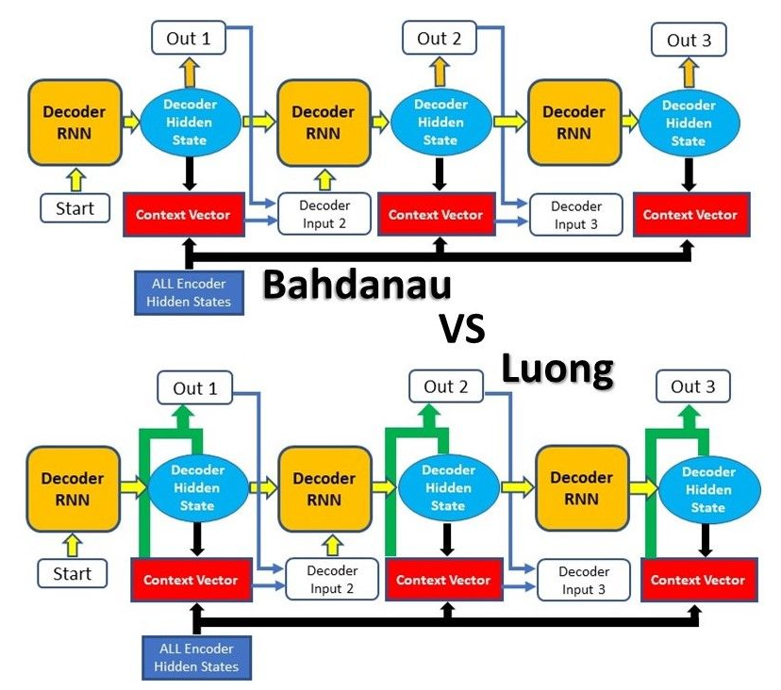
Popular Attention Mechanisms

Slide 30
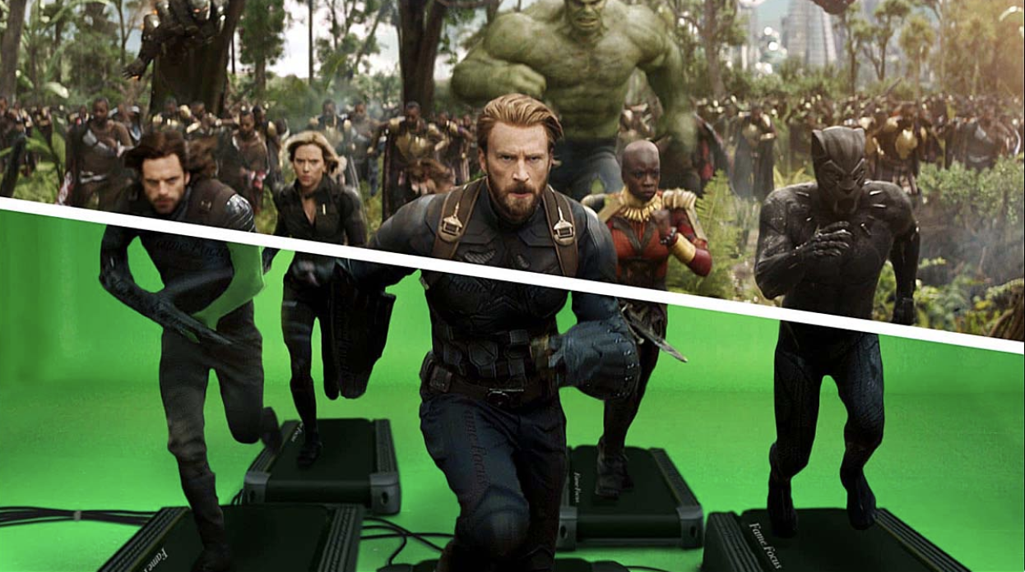
Where we run? / Kaggle
Kaggle Dataset for Images
Version in Background
Private Data 100 GB
GPU 41 hrs per week
TPU 30 hrs per week

Slide 31
Development
Python ML and Deep Learning Tools
Development Environments
Kaggle Notebooks and Dataframe
Local Jupyter Lab
Local Visual Studio Code

Slide 32
Management of Artefacts
Git-Hub
Source code
Small data files (up to 25 MB)
Google-Drive
M5 Model files
Presentation

Slide 33
Modeling
Keras API
Keras ImageDataGenerator and custom implementation Resized images e.g. 299x299x3

